Slide 1

ASTROSAGE
ANALYSIS
This business provides online astrological consultations, personalized astrology services, and astrological research. They feature a team of expert astrologers for personalized guidance. Services include horoscope predictions, AI-powered astrology, birth charts, and compatibility reports.

Slide 2
Data Overview
createdAT: Timestamp when the session was created. Used to analyze trends over time.
consultation Type: Type of session (e.g., Chat or Call). Helps identify usage patterns.
guruName: Name of the astrologer who handled the session. Used to evaluate agent performance.
chatStatus / callStatus: Indicates whether the session was completed, failed, or incomplete.
user / uid: Unique ID for each customer. Used to track repeat users.
CallSid: Unique identifier for each call. Helps in counting total calls.
amount: Amount paid by the user for the session. Important for revenue analysis.
astrologers Earnings: Amount earned by the astrologer. Used to compare earnings vs. performance.
net Amount: Company’s profit from the session after deductions.
rating: User satisfaction score based on the session. Crucial for quality analysis.
region: User’s location. Helps in regional performance or targeting.
chat Seconds / user Call Duration: Duration of the session in seconds. Used for performance and efficiency analysis.

Slide 3
Problem Statement
AstroSage has received a 1 crore investment and aims to optimize its call center operations. The goal is to determine how to allocate this investment to maximize operational efficiency, customer satisfaction, and profitability. The analysis will consider historical call data, performance metrics, and market trends to make informed decisions.

Slide 4
OBJECTIVES
The primary goal is to provide a comprehensive and data-driven view to stakeholders.
The primary goal is to provide a comprehensive and data-driven view to stakeholders.
The primary goal is to provide a comprehensive and data-driven view to stakeholders.
The primary goal is to provide a comprehensive and data-driven view to stakeholders.

Slide 5
METHODOLOGY
Dashboard
The Data is summarized and shown in form of charts for easy understanding
Data Analysis
Data is analyzed for KPI’s and key metrics
Data Cleaning
The raw data is cleaned by using different excel functionalities and dropped some irrelevant columns.
Key Insights & Patterns
Provide suggestions on the basis of insights for customer satisfaction and profitability boost.

Slide 6



KPI’s
[Key Performance Metrics]
Total users
Net Revenue
Number of Calls
DESCRIPTION
There are total 27950 users.
The Net Revenue of the Industry is 213825.9 rs
The Total Number of 8339 calls have been done.

Slide 7
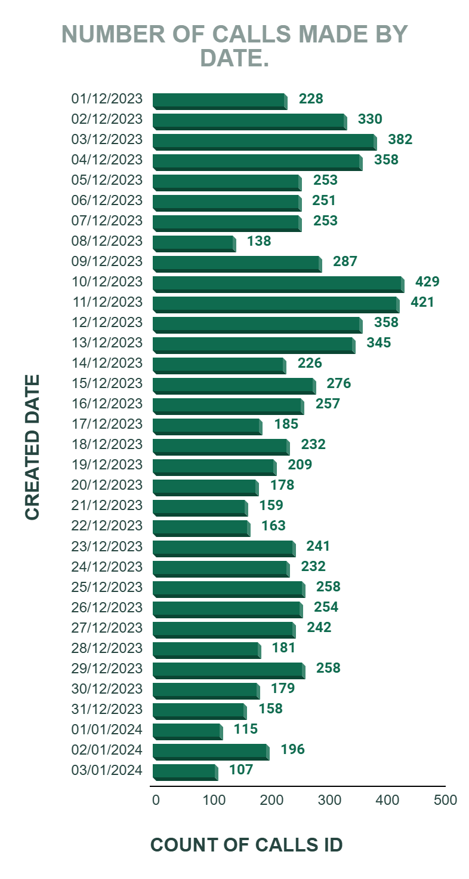
APPROACH
The average daily call volume is 250.
On 10/12/23 there was highest call volume i.e 429.
On 03/01/2024 there was lowest call volume i.e. 107.
December : Highest call volume.
January : Lowest call volume.
Call centre receive approx. 250 calls per day but only 40.77% of calls gets complete in total from astrologer side.
RECOMMENDATION
There is a need of hiring new skilled agents and freelancers to manage the workload of existing agents.

Slide 8
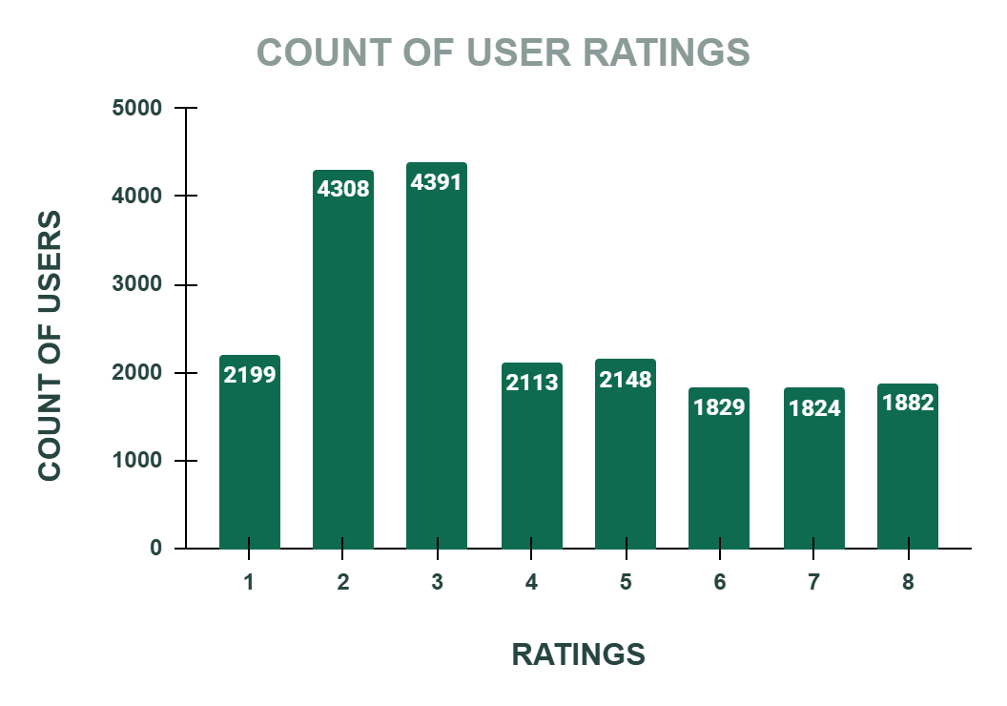
APPROACH
Satisfied user (Rating-5,6,7,8) =
37.13%
Unsatisfied user (Rating-0,1,2,3,4) = 62.87%
Out of 8339 calls only 3542 calls are getting completed, which is 40.77%.
The remaining 59.23% of users are not getting the service despite of booking the call session.
RECOMMENDATION
Invest in training programs for the agents, by which they will get training to give better service to the users and manage time properly.

Slide 9
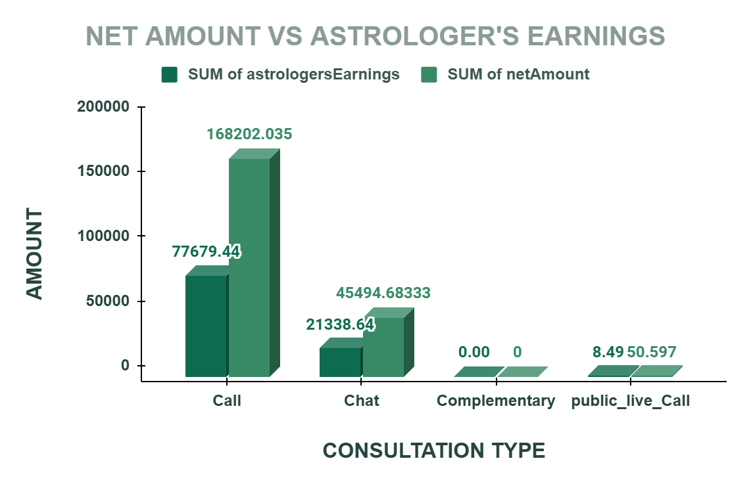
APPROACH
The 78.69% of the total net income for the company comes from Call service only.
And the 78.44% of the total income for the astrologer comes from Call service.
Total revenue = 213825.9 rs.
Correlation between net income and astrologer earning is 0.997,which suggests a very strong positive linear relationship between two variables.
RECOMMENDATION
So if the call service is a key revenue driver, investing in training programs would be a strategic move to sustain and enhance that success.

Slide 10
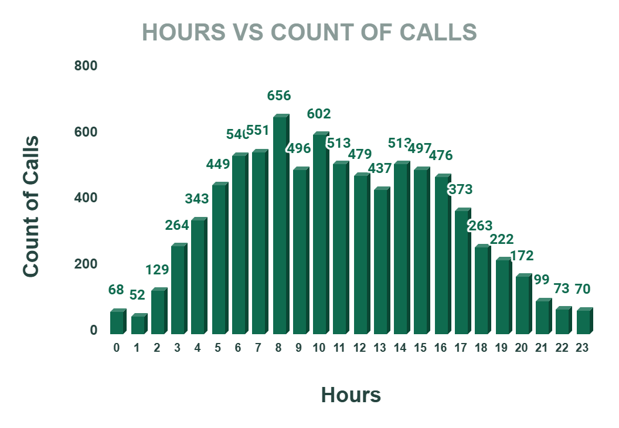
APPROACH
Around 8.00 am the traffic of the callers are very high.
Around 01.00 am at night the traffic is very low.
Approx 660 users calls around 8.00 am.
There are only 150 agents.
RECOMMENDATION
Hire part time or freelancer agents , this reserve agents will balance the workload without increasing permanent cost.
Shift optimization- Optimizing more agents shifts to peak periods accordingly. Ensure that more agents are scheduled during high – traffics time.

Slide 11
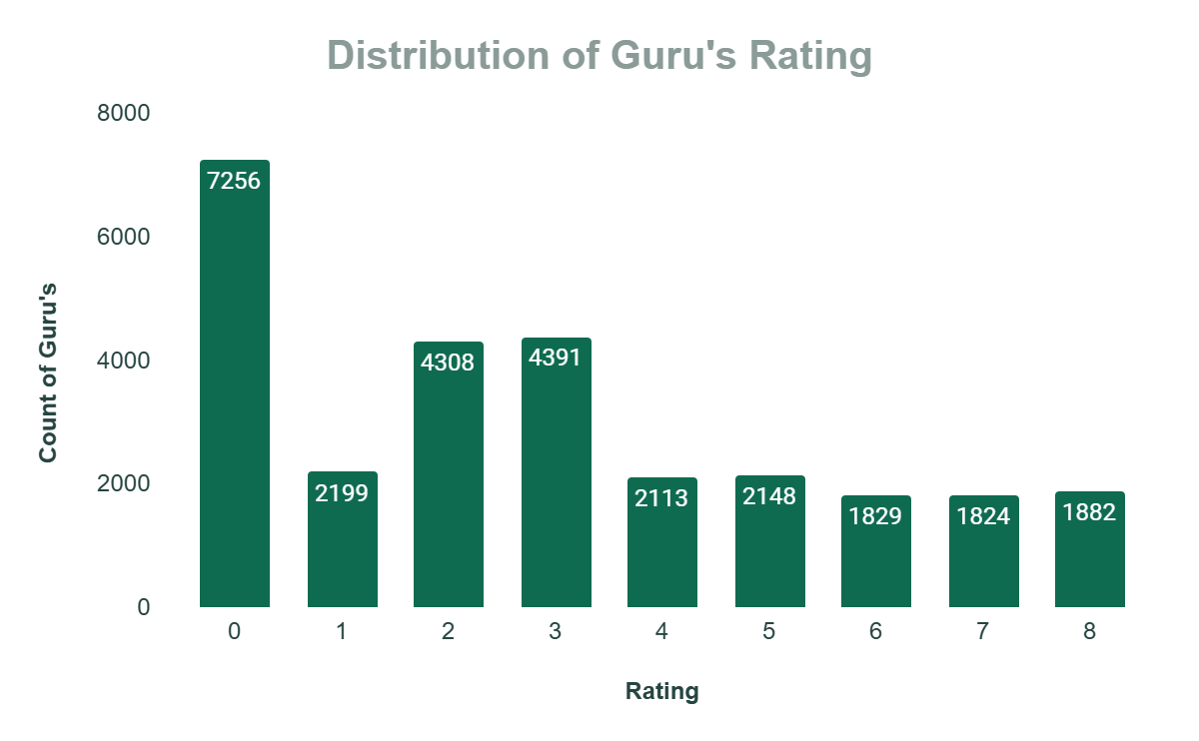
APPROACH
7256 times Guru gets the rating of 0.
Satisfied user (Rating-5,6,7,8) = 37.13%
Unsatisfied user (Rating-0,1,2,3,4) = 62.87%
RECOMMENDATION
Company should run training program which include-
Call Handling Techniques
Enhancing Skills
Cross-Selling:
Adaptation to Growth

Slide 12
APPROACH
Astro Krishaa ( Guru id -287 ) got the highest number of 8 which is 169 times,
which is highest satisfaction score earned guru.
Astro Yogendra (Guru id- 201 ) got the highest number of 0 i.e. 493 times , which is lowest satisfaction score earned guru.
RECOMMENDATION
Company can implement strategies like:
Professional development and training.
Clear performance metrics.
Recognition and reward.
Upgrade technology and tools.
Top 10 Guru’s
Astro Krishaa
Astro Ruchi
Astro Ashok
Astro Sonam S
Astro Divya
Astro Trisha
Astro Sakthi
Tarot Gurpreet Kaur
Tarot Vedika
Astro Seema

Slide 13
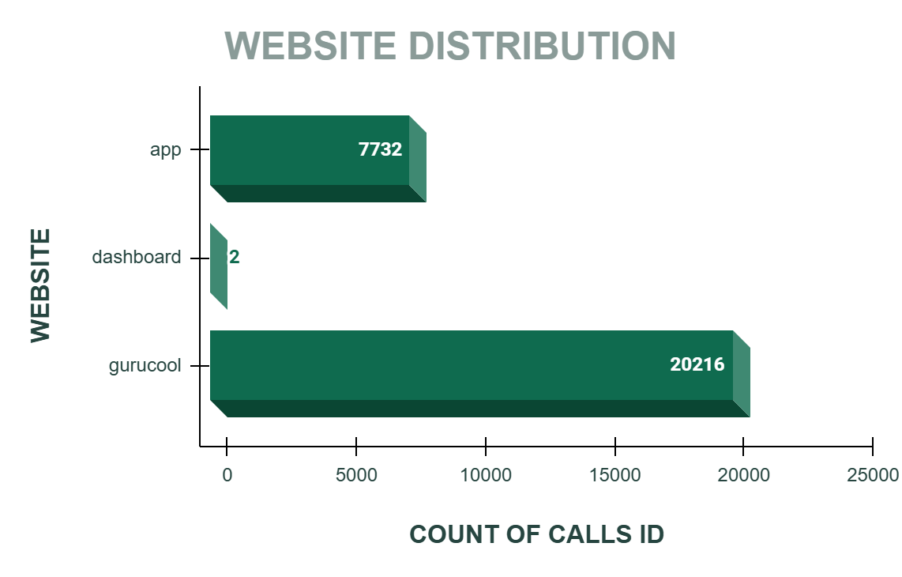
APPROACH
72 % of users use Gurucool website.(Source of consultancy)
28 % of users use App. (Source of consultancy)
Highest sales generated by App i.e. 125267.38
RECOMMENDATION
Gurucool is only one platform which provide the service of the Chat to the users.
But the average rating of the Gurucool is 2.72, which is the clear indicator of unsatisfied users.
So it is very necessary to improve technology and provide satisfaction to the users

Slide 14
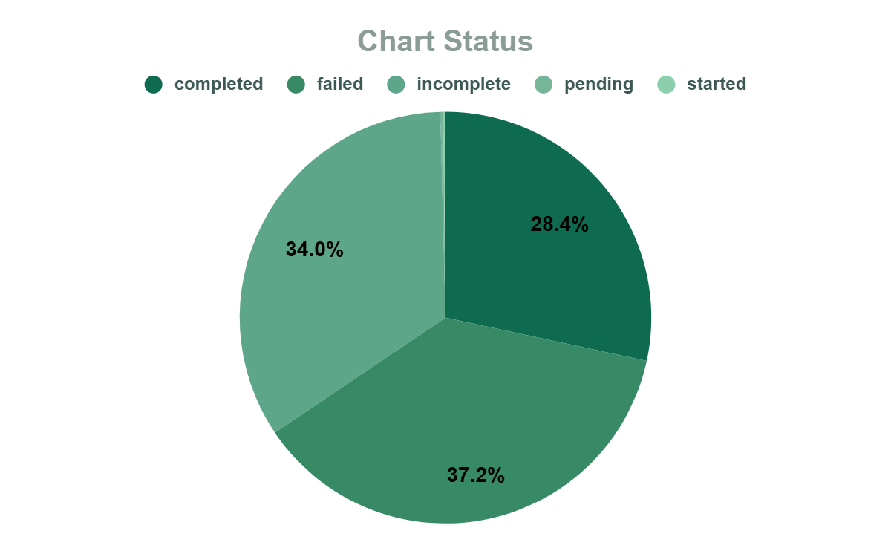
APPROACH
28.4% of chats get completed between agents and users.
34% of chat remain incomplete.
While 37% of chat get failed.
69.62% of total users use chat service and gurucool is only website which provide chat service.
RECOMMENDATION
Investing in gurucool technology upgrades will help to improve the overall experience and will help to increase the retention rate of the users. And increase the user satisfaction as it is only 2.71 for chat service.

Slide 15
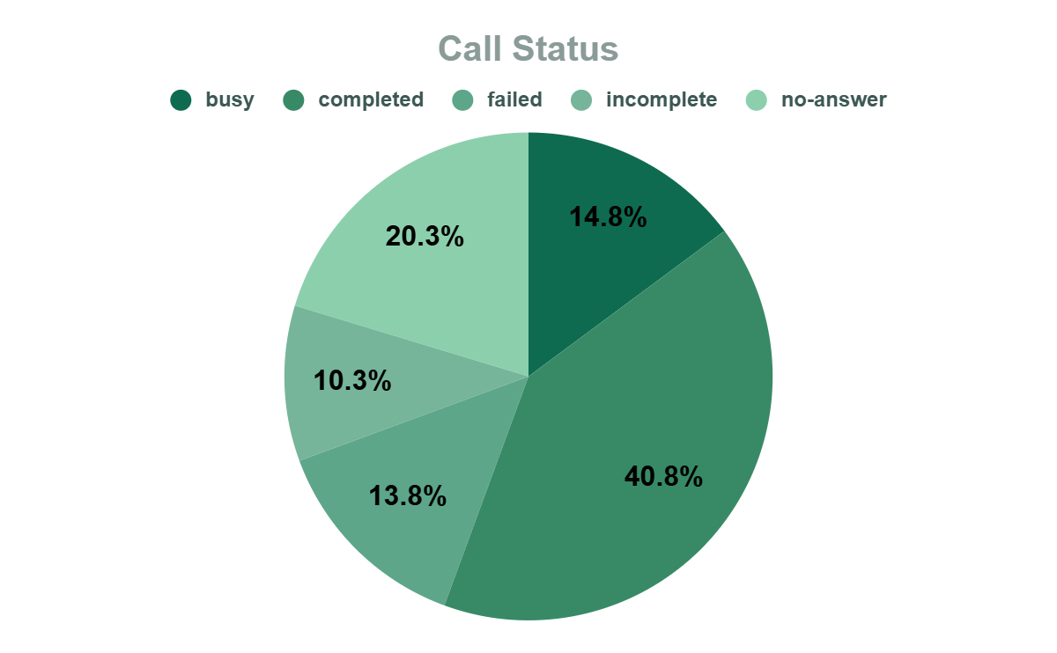
APPROACH
Only 41% users call get completed.
20% of user didn’t get any answer.
While 14% users call get failed.
And 10% of users call remain incomplete.
RECOMMENDATION
Hire part time or freelancer agents, this reserve agents will balance the workload without increasing permanent cost.
Shift optimization: Optimizing more agents shifts to peak periods accordingly. Ensure that more agents are scheduled during high – traffics time.

Slide 16
ANALYSIS
0.997
1
40.77%
37.13%
69.62%
Correlation of net revenue and astrologer earning.
This suggest the positive relation. As the astrologer earning will increase the net revenue will also increase.
Completed calls
Out of 8339 only 3452 calls get completed.
Satisfied users
Out of 27950 users only 7683 users gave rating of 5,6,7,8(satisfactory score).
Chat service
Out of 27950 users 19510 users use chat service.

Slide 17
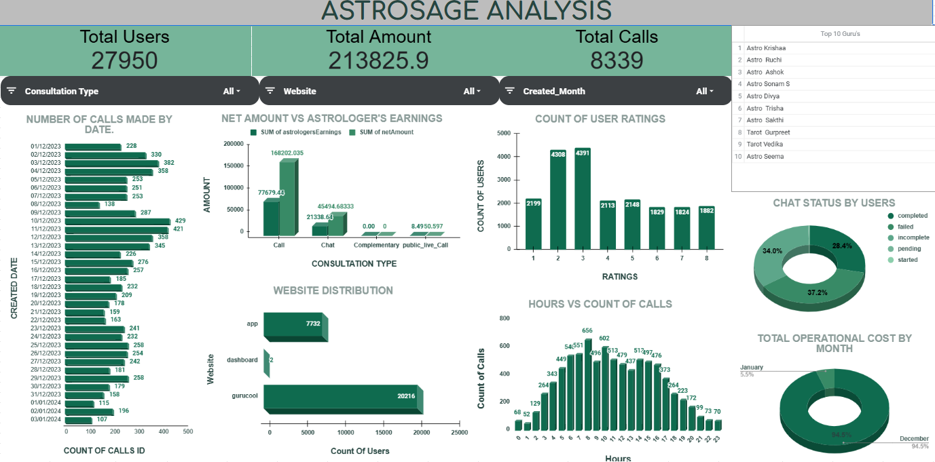
DASHBOARD

Slide 18
RECOMMENDATIONS
AFTER ANALYZING ALL THESE INSIGHTS I RECOMMEND THE COMPANY TO INVEST 1 CRORE IN THREE PHASES:
1. Technology Upgrade – ₹40 lakhs (40%)
As Exotel is the only cloud phone system with which company work, fund should be invested in building another cloud phone system to manage the burden
Buy new high-tech equipment.
Upgrade the chat platform (UI/UX).
Introduce AI chatbots for instant query resolution.
Improve backend performance to reduce lag or crashes.
2. Agent Training Program – ₹25 lakhs (25%)
Conduct monthly training on soft skills, upselling, and technical handling.
Use analytics to identify underperforming agents and offer targeted coaching.
3. Support Infrastructure, Data Security & Customer Care Tools – ₹35 Lakhs (35%)
Hire freelance/part-time agents to manage peak hours and reduce customer wait time.
Invest in infrastructure and data protection (cloud backups, system stability).
Set up automated feedback tools (post-call surveys, follow-ups) to improve customer support and satisfaction.

Slide 19

CONCLUSION
To address the problem statement, I conducted a comprehensive analysis by cleaning the data, creating pivot tables, charts, and developing an interactive dashboard. These insights have been instrumental in drawing meaningful conclusions and supporting data-driven decisions. This project offered a valuable opportunity to apply and enhance my Excel skills, and I thoroughly enjoyed working on it.”

Slide 20
THANK YOU ..
NAME : KIRAN KUMAR PRADHAN
BATCH : MAY-2025

